Slide 1
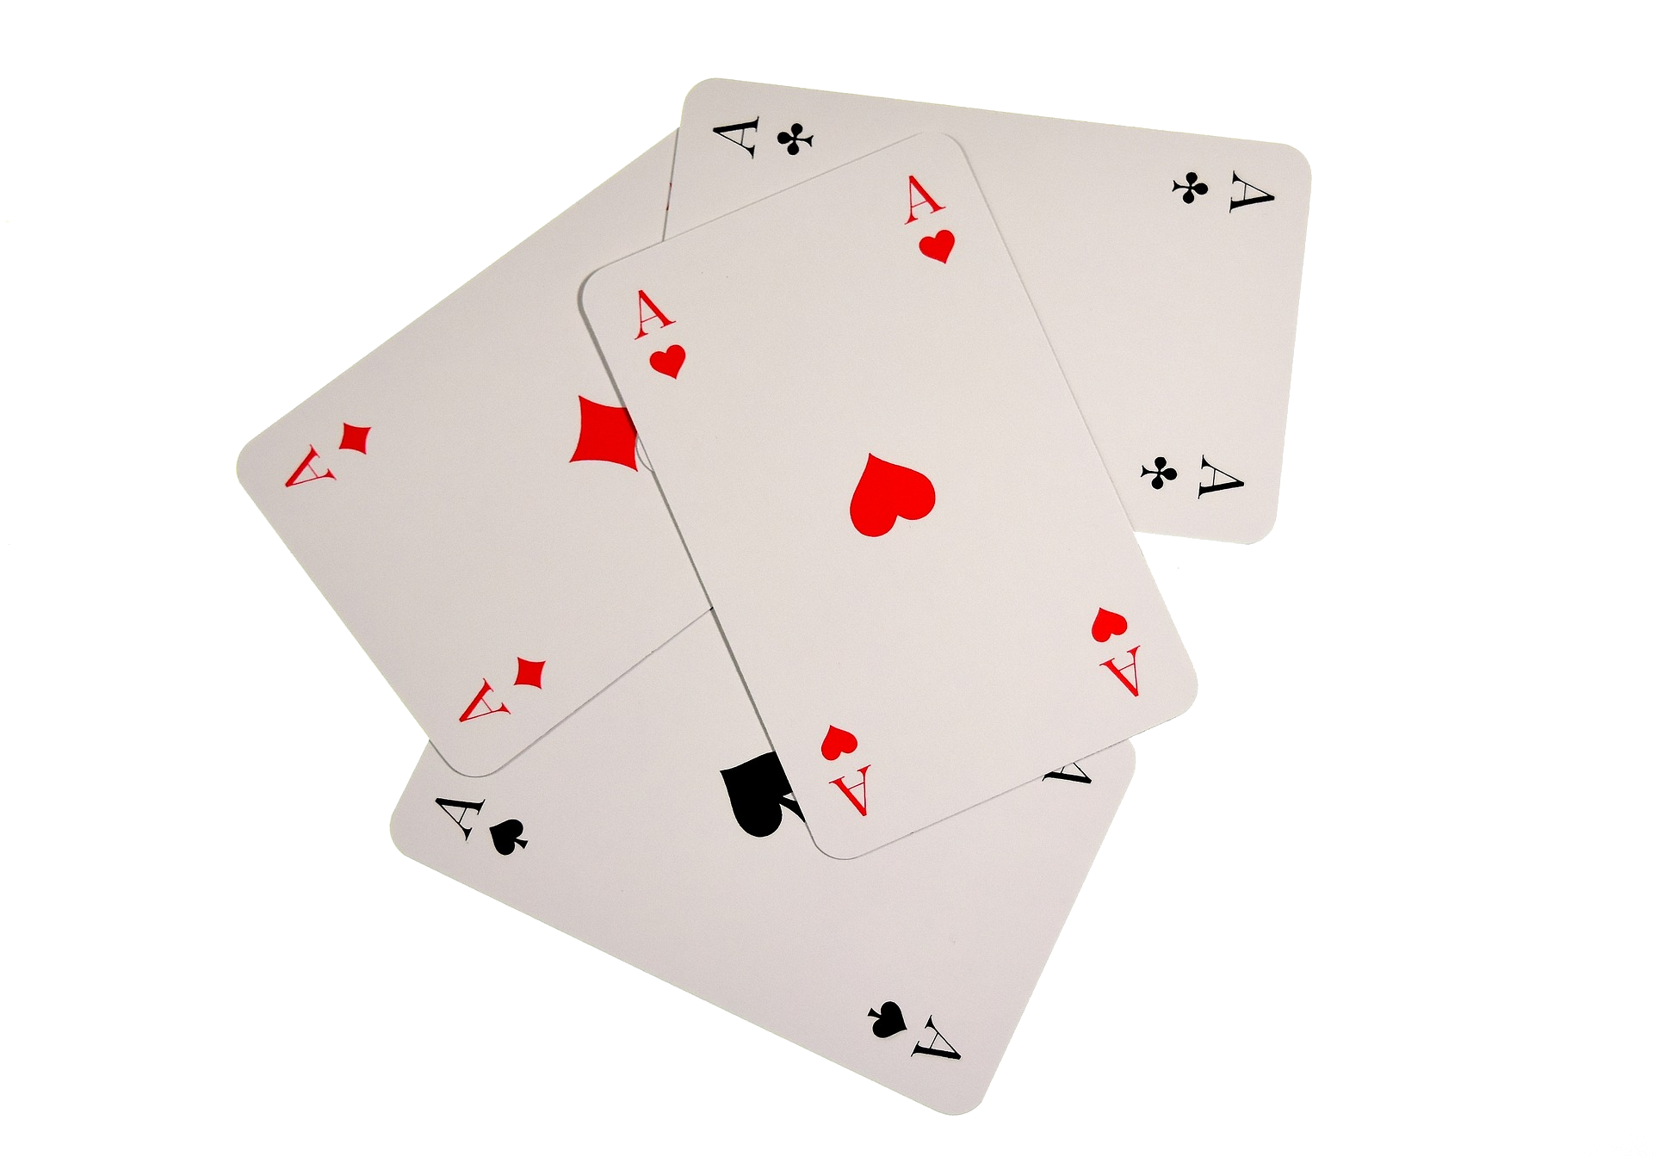
History of Computers, Simulations, & Games
A Brief Introduction

Slide 2
Computer & Games Like Peas and Carrots
Computer games are the earliest simulations – and they have been around
1st “Modern” Computer (ENIAC)
1st Transistor Computer (CADET)
1st home micro-computer w. CRT (Micral C)
1946
Stored-Program (Manchester Baby)
1955
1st Minicomputer (PDP-1)
1st Microprocessor (Intel 4004)
1976
1948
1960
1971
1951
1961
1972
1950
“Draughts”
1st PDP-1 game (Spacewar!)
1962
1st Home “Video” Game (Odyssey)
1976
“Bertie the Brain”
1st Text Editor (“Expensive Typewriter”, PDP-1)
1st Programmable Home Console (Channel F)
Mainframes
Minicomputers
Microcomputers
Notes:
Modern: Digital, electronic, turing complete Video Game: Display, Interaction, Amusement

Slide 3
Evolution of Games
Computer games evolved through development stages.
Simluation of physical world – (board games / sports)
Simulated fictional environments (1960s)
Arcade & Adventure (1970s)
Composite (1980s)
Set pieces (1990s)
Notes:
-Physical games: Bertie the Brain / Draughts / Chess / Mouse-in-a-Maze
-Fictional games, minicomputer: Spacewar!, Space Travel, Ping-Pong prototype
-Arcade games: Pong, Western Gun, Breakout -Adventure games: Colossal cave adventure

Slide 4
The Early Arcade Era
Early arcade systems focused on repeating objectives:
Spacewar! – Blow up the rocket; don’t die
Galaxy Game – Also blow up the rocket & don’t die
Pong – Outscore the other player
Western Gun – kill the other player
Later games (e.g. Speed Race) would add growing difficulty.

Slide 5
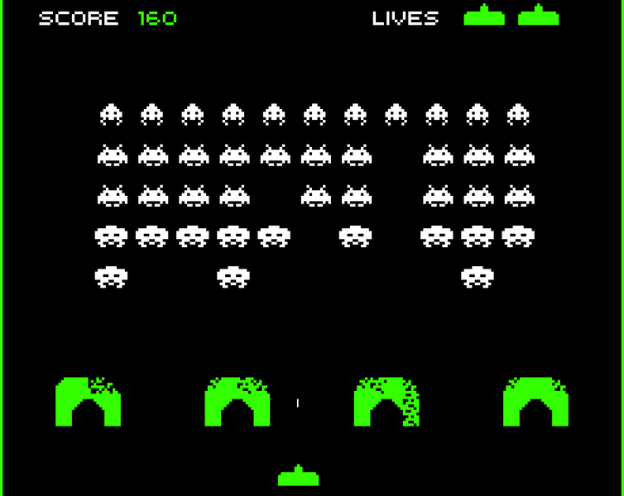
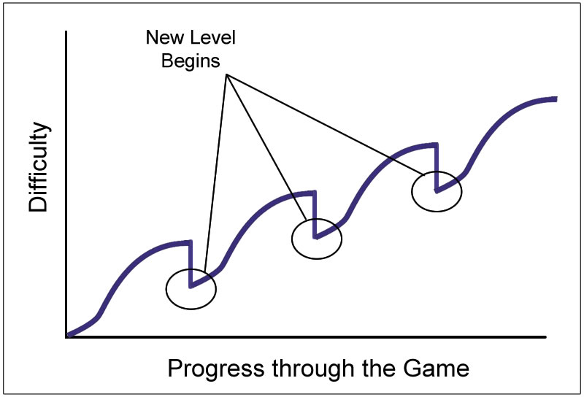

Nishikado’s Lucky Mistake
Tomohiro Nishikado wrote “Space Invaders” (1976).
Difficulty increases by level (closer enemies)
Game speeds up with fewer enemies – originally a bug
…and games were never the same again!
お前はもう死んでいる
Some refer to this pattern as "Nishikado Motion".

Slide 6
Adventure in Text
Narrative games arose with Colossal Cave Adventure (1976).
Narration of description in text
Text based commands
Room-based area design
YOU ARE STANDING AT THE END OF A ROAD BEFORE A SMALL BRICK BUILDING.
AROUND YOU IS A FOREST. A SMALL STREAM FLOWS OUT OF THE BUILDING AND
DOWN A GULLY.
go south
YOU ARE IN A VALLEY IN THE FOREST BESIDE A STREAM TUMBLING ALONG A
ROCKY BED.
The first multiplayer online text adventure, MUD, was released in 1978.

Slide 7

Paku-Paku, Dude!
In 1980, Namco released Pac-Man by Toru Iwatani.
First original game mascot character
First power-ups
First cut-scene
Multiple unique characters
Switching between chasing & fleeing
Pac-Man also heralded the beginning of a character-driven AI.

Slide 8
Graphical Adventure Games
King’s Quest (1983) added interactive graphics to adventures.
Character, like “arcade games”
Text commands, like adventure games
Rich animations and 16 COLORS!!!

Slide 9
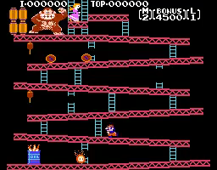
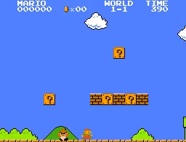
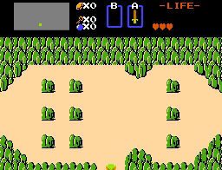
Composite Games
Hardware advances facilitatied more complex composite (mixed genre) games.
Combined multiple types of play
Often facilitated by power-ups that introduce “abilities”
More fun rather than merely more difficult
Allows richer variation & styles of play as needed
Donkey Kong (1981)
Super Mario Bros. (1985)
Legend of Zelda (1986)
These games – made famous by Super Mario Bros. – are widely credited with the game revival of the 1980s.

Slide 10
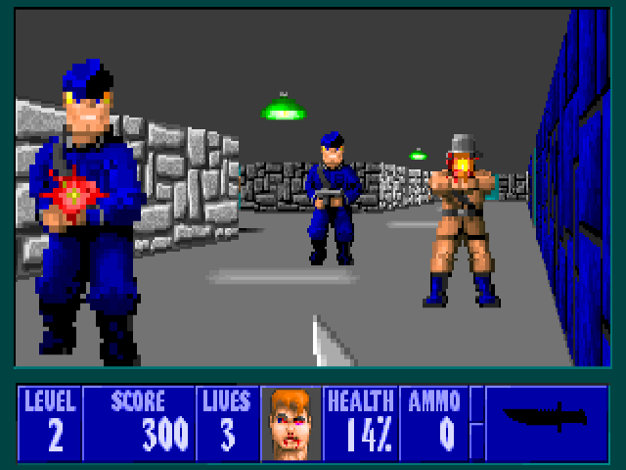
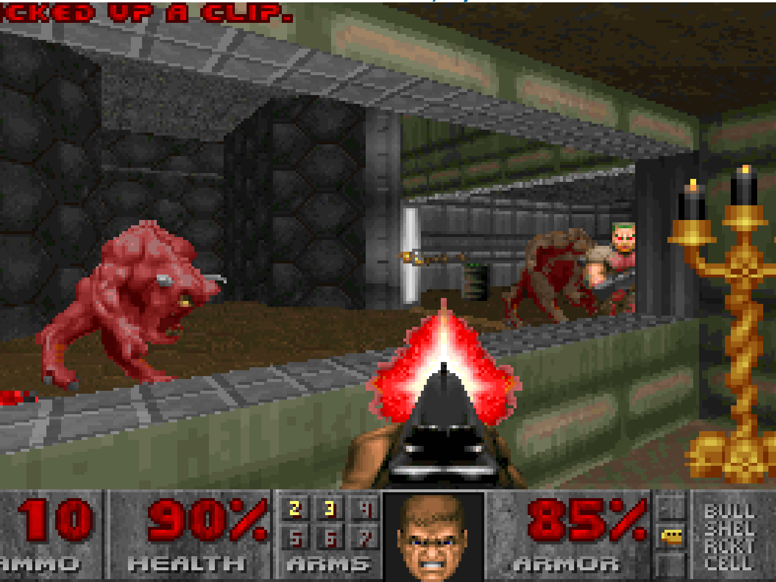
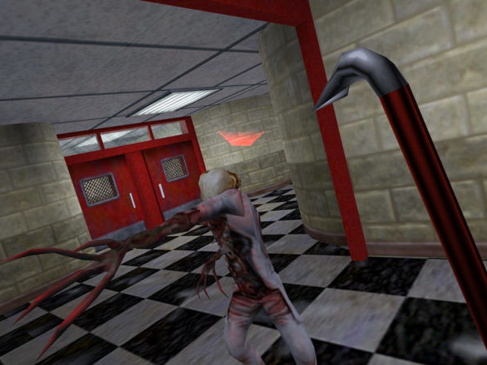
Lights, Camera, Action!
As the cost of assets skyrocketed, set piece designs took hold.
Often simulated 3D space
Focused on scenes to build a narrative
Use new assets sparingly – fewer, and long
Wolfenstein 3D (1992)
Doom (1993)
Half-Life (1998)

Slide 11
References
Holleman, P. The History and Evolution of Videogames Design. https://www.youtube.com/watch?v=ct8a3D7FvB0
The Strong National Museum of Play. Video Game History Timeline. http://www.museumofplay.org/about/icheg/video-game-history/timeline
Smithsonian Institution. Video Game History. https://www.si.edu/spotlight/the-father-of-the-video-game-the-ralph-baer-prototypes-and-electronic-games/video-game-history

